Slide 1

Pentwynmawr
Primary School
PROSPECTUS

Slide 2
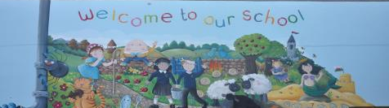
Welcome!
Dear Parents,
On behalf of the staff, governors and children it is my pleasure to welcome you to Pentwynmawr Primary School.. Choosing the right school for your child is vitally important. All parents want a good education for their children but they also want them to be happy and to feel safe and secure.
At Pentwynmawr we believe we can offer all these things. We provide a broad, balanced and full education at all stages. We have high standards of teaching and learning within an atmosphere of friendliness and co-operation. We promote good relationships with parents as we feel that children’s all round progress depends on a close partnership between home and school. We believe that working together will help your child to achieve his/her full potential.
This prospectus contains information about the school organisation, staffing and general data, which will be of general relevance to you as parents. However, it is possible that there may be information that you require which is personal to you and not contained in this prospectus. Should this be the case, and you need to discuss a personal matter, please telephone the school to make an appointment.
If you have any queries or concerns now, or in the future, please contact me at the school.
With Regards
J M Nash Head Teacher

Slide 3
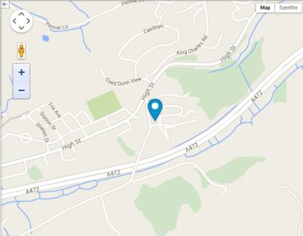
Contact Details
Pentwynmawr Primary School
Tonypistyll Road
Pentwynmawr
NP11 4 HJ
ptwpa@caerphilly.gov.uk
01495 243 400
Website: www.schoolswire.org Then add the post code above
Chair of Governors: Mrs. F Wilkins
Head Teacher: Mrs. J M Nash BA Hons, PGCE, NPQH

Slide 4
Success for all, success for life
Our school motto, “Success for all, success for life” reflects our aim for all children to develop self-awareness, improve on their own standards and to strive to achieve the best they can both socially and academically.
Mission Statement
In Pentwynmawr Primary School we aim to provide a stimulating, challenging, happy and safe environment for all involved in the school community. The use of ICT is an integral part of everyday practices.

Slide 5
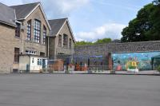
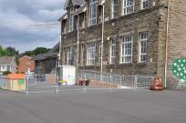
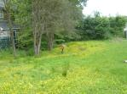
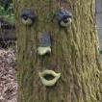
Our School
Pentwynmawr Primary School opened in a temporary building on 20th November 1908. The present building was opened on 28th October 1912 and was once a separate Infant and Junior School. Now, when children begin at nursery they remain until they move to the comprehensive school at the age of eleven. The children are arranged in mixed ability classes. There are currently four classes. Estyn reported in 2010 that Pentwynmawr School is a good school because;
• nearly all pupils make at least good progress in their learning in most areas during their time at the school;
• pupils have a strong voice within the school and their opinions are valued and acted upon;
• the school has a strong community focus and its ethos encourages the pupils to be active citizens who care about each other and the world around them; and
• the teachers know the pupils well. They provide activities, which make good use of the well-resourced environment, both indoors and outside.
Pentwynmawr Primary school is a member of Newbridge Cluster of Schools. These include: Crumlin High Level, Pantside, Primary, Tynewydd Primary, Abercarn Primary, Cwmcarn Primary, Waunfawr Primarry, Newbridge Comprehensive

Slide 6



We aim:
To maintain a happy, caring environment in which children feel secure to grow and develop intellectually, socially, emotionally, culturally, spiritually and physically to their full potential.
To use the resources available to provide the best possible educational opportunities for the children in our care.
To provide a broad and well taught curriculum where children have many wide and varied experiences.
To continue to work in partnership with parents.
To encourage children to make healthy food choices and take regular exercise.
To give children opportunities to develop independence and the responsible attitudes that will enable them to become active and caring members of the community. We want all children to feel that they have an important contribution to make to the whole school, to their community and to society.
To encourage pupils to behave fairly, respectfully and to make the right choices.
To instil a respect for the environment in which we live as well as a sensible attitude towards health and safety.
Knowing children are naturally inquisitive, we aim to use this to guide the children to discover much for themselves; thus laying a foundation for independent learning.
We want all our pupils to be proud of their achievements, their school and their community.

Slide 7
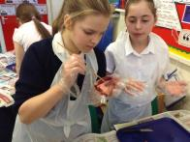
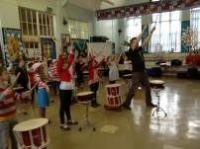
Curriculum
Our broad and balanced curriculum provides our pupils with opportunities to engage in learning that is creative, challenging and experiential. We aim to offer a diverse range of experiences that inspire all of our children. We want our children to be highly motivated, have a thirst for knowledge, a love of learning and to have confidence in themselves and in what they achieve. All teaching is carefully planned and structured to ensure children are given every opportunity to develop as effective learners and responsible citizens.
Pupils are taught in a variety of settings through a range of teaching strategies, for example whole class, small group, in pairs or individual. We ensure that opportunities for different styles of learning are catered for within our teaching. Such flexibility and variety guarantees that we meet the individual needs of our pupils.
There are two main phases of education in our school: Foundation Phase and Key Stage Two.

Slide 8

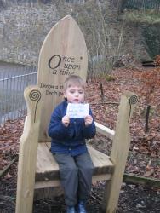
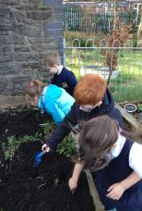
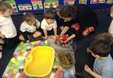
Foundation Phase
The Foundation Phase consists of Rising Threes, Nursery, Reception, Year 1 and Year 2 children. It covers seven areas of learning:
Language, Literacy and Communication
Mathematical Development
Physical Development
Creative Development
Knowledge and Understanding of the World
Personal and Social Development, Well Being and Cultural Diversity
Welsh Language Development
The school provides a broad and rich framework that includes outdoor learning and outdoor play.
We aim to nurture pupils to become confident and inquisitive individuals with good literacy and numeracy skills whilst recognising their level of maturity and stage of development.

Slide 9
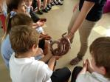
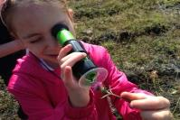
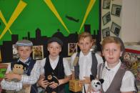
KEY STAGE 2
This stage includes pupils from Year three to Year six.
The curriculum for Key Stage 2 consists of three core subjects, English, Mathematics and Science.
In additional there are the following foundation subjects; Art and Design, Music, Welsh Second Language, ICT, Design Technology, Physical Education, Religious Education, Personal and Social Education, Geography and History.
Literacy and Numeracy skills taught in English and Mathematics are applied across the curriculum.
Dynamic and diverse learning opportunities are provided through a themed approach to learning.

Slide 10

Additional Learning Needs
We value the abilities and achievements of all our pupils and are committed to providing each pupil with the best environment for learning.
All staff encourage and support pupils to reach their full potential and promote self-esteem and success.
Every teacher is concerned with the whole child and is aware of the importance of early identification of a child’s special educational needs.
The school has a Special Needs policy approved by the Governing Body and there is a Governor designated as Governor for Special Needs.
Children may have special educational needs, which may have an affect on their progress in school. The problems they experience may arise as a result of a physical, social, emotional or perhaps a medical condition. It may be that a child has a specific need in one area, which affects academic progress. Parents will be informed if there is any cause for concern. Appropriate arrangements are made for pupils identified with special needs, including support with lessons or withdrawal for extra help.
It may be necessary to refer some pupils to the Educational Psychologist. Parents will be fully informed if this proves to be the case. If a child has long term special needs the head teacher may request statutory assessment. The Educational Psychologist may then draft a “statement” for the child. This may mean that the child will be granted extra help, either within their own school, or in a special school, or unit, which is more suited to their individual needs.

Slide 11
More Able and Talented
A pupil is also considered to have additional learning needs if they are very able and the school provides them with enrichment and extension activities as appropriate.
A booklet is available from the Heads Office on how to support More Able pupils at home.
Pentwynmawr Primary School has a proud record of provision for pupils with special needs and this continues.

Slide 12
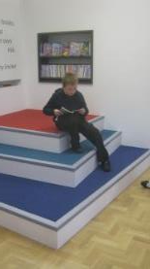
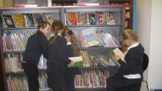
Literacy Skills
Reading, writing, speaking and listening skills are taught in English and applied throughout all other areas of the curriculum.
Pupils are encouraged to use standard English in their talk. We develop pupils to become confident speakers and presenters.
In reading, the broad aims are to enable children to read fluently and with understanding a variety of materials, to read for pleasure and for information. We aim to develop the children’s ability to retrieve information for the purpose of study. Children are encouraged to practice reading at home in order to develop mastery of this crucial skill.
Writing, in a variety of genres is regarded as an important part of the language curriculum. Pupils are also provided with many opportunities to write across the curriculum through their topic work.

Slide 13
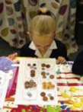

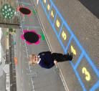

Numeracy Skills
Mathematics and mathematical skills are taught through practical experiences, which lead to the development of sound concepts. Pupils are encouraged to extend their mathematical thinking by solving mathematical problems, communicating and reasoning mathematically using contexts from across the whole range of mathematics, across the curriculum and as applied to real-life problems.
Pupils extend their use of the number system, moving from counting reliably to calculating fluently with all four number operations, including in the context of money, in order to solve numerical problems.
They develop estimation strategies and apply these to check calculations, both written and by calculator.
They explore a wide variety of shapes and their properties and, in the context of measures, use a range of units and practical equipment with increasing accuracy. They collect, represent and interpret data for a variety of purposes. They select, discuss, explain and present their methods and reasoning using an increasing range of mathematical language, diagrams and charts.

Slide 14
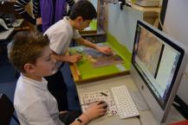

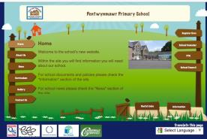

I.C.T.
The school has an ICT suite, interactive whiteboards, flat screen TVs and ipads in all classes.
The school has an online website for students and parents
Website: www.pentwynmawrprimaryschool.co.uk
Pupils are taught a range of ICT skills and apply these skills across all areas of the curriculum.
Pupils are taught Internet safety.

Slide 15
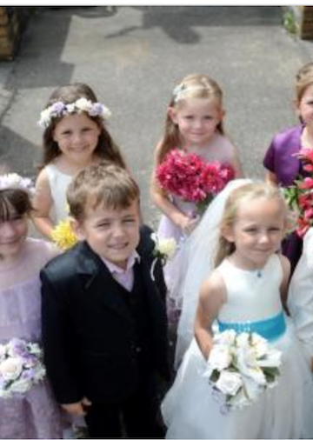


Religious Education and Collective Worship
Religious education is provided as part of the curriculum under the guidelines of the 1998 Education Reform Act and in accordance with the statutory requirements.
The approach is multi-cultural with an emphasis on Christianity. The programmes of study and attainment targets are approved by the Standing Advisory Council , SACRE.
Collective Worship in school is conducted through daily whole school assemblies. A “Celebration Assembly” takes place on a Friday. In this assembly the star of the week for each year group is presented with a certificate. Pupils are encouraged to bring trophies and certificates received out of school to this assembly to share with their friends.
Visiting speakers often take assembly.
Any parent who wishes to exercise their right under the 1998 Education Reform Act to withdraw their child from assemblies or R.E. lessons are asked to contact the head teacher in writing.

Slide 16
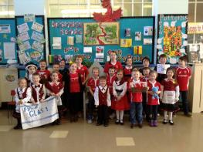
The Welsh Language
All pupils receive regular Welsh lessons and incidental Welsh is used during the school day.
It is a National Priority that pupils become bilingual. All pupils are taught to speak Welsh and to read and write welsh.
Welsh is an integral part of the school curriculum. The experiences presented to pupils include opportunities to take part in drama and role-play activities.
We foster an interest in the Welsh language and culture and pride in our heritage and country.

Slide 17
Sex and Relationships Education
A policy for sex and relationships education is in place and a statement has been written and approved by the Governing Body.
Sex and relationships education is mainly delivered through the Personal and Social Education Framework.
Sex education is taught as part of the Health Education Programme.
Parents have the right to withdraw their child from sex education should they wish to.
Education about relationships for 3 to 11-year-olds focuses on the building of self-esteem by encouraging learners to value themselves; to recognise and communicate their feelings form friendships and relationships.
Pupils in Year 6 are taught the reasons for the physical and emotional changes that take place at puberty.

Slide 18
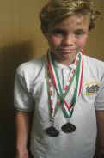
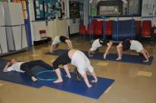
Sport and Physical Education
Physical Education is a statutory requirement and an essential component in establishing a basis for a healthy life style. Pentwynmawr Primary School is a healthy school with a strong sporting tradition. The school has a netball court, football pitch and an outdoor adventure trail. In addition we have a range of equipment for use at break and lunch times.
Any child unable to do P.E. at any time, must bring a note to school, explaining the reasons.
All children are expected to have an appropriate P.E. kit. Persistent ‘forgetting’ of kit will be dealt with as a disciplinary matter and parents will be informed.
Physical education encourages learners to explore and develop the physical skills essential to taking part in a variety of different activities. Building on these skills are opportunities to be creative and imaginative in gymnastic and dance activities. Through adventurous activities, they learn how to swim, be safe and feel confident in water and how to read a map or follow trails.
Competitive activities offer the chance to learn games skills and play in a team, as well as how to run faster, jump higher and throw further. Learners are taught that physical education is about learning how to feel healthy and stay fit while having fun, and knowing how these different types of activities help them to stay that way.

Slide 19

Jewellery
Jewellery presents us with a problem at times in school, particularly for games and physical education.
Earrings pose a particular problem and can cause serious physical damage to a child. Substantial injuries have been recorded at playtimes, and during PE lessons throughout Wales and England, through the wearing of jewellery.
Therefore we do not allow children to wear any jewellery in physical education lessons.
We would therefore suggest that children are discouraged from wearing jewellery to school. The exception to this is the wearing of watches, which are the responsibility of the child.
Parents are advised that they cannot (by law) stipulate that they will take responsibility for injury to a child caused by wearing jewellery for P.E.

Slide 20
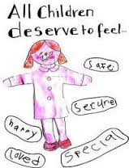

Safeguarding
The school has
Established and maintains an ethos where children feel secure and are encouraged to talk, and are listened to;
Ensured that children know that there are adults in the school whom they can approach if they are worried or in difficulty;
Included in the curriculum, activities and opportunities for Personal and Social Education that equip children with the skills they need to stay safe from abuse or exploitation, both in their own communities and the cyber community, and to know to whom to turn for help;
Included in the curriculum, material which will help children develop realistic attitudes to the responsibilities of adult life, particularly with regard to childcare and parenting skills.
The school follows the All Wales Child Protection Procedures and all local protocols in relation to Safeguarding that have been endorsed by the South East Wales Safeguarding Children Board.

Slide 21
Security
Every effort is made by the Local Authority and Governing Body to ensure the security of our school site.
The grounds are fenced and CCTV is in place in certain areas.
Within school hours no child is allowed to leave school premises unless accompanied by a known adult.
Visitors to the school can only enter via the main entrance, which is electronically controlled. All visitors must identify themselves before entry is allowed and must then sign in at the secretary’s office.
All staff and volunteers have been DBS checked.
Fire drills are conducted on a regular basis and the date and duration of evacuation time recorded.

Slide 22


Mobile Phones
In order to keep all our pupils safe and in accordance with safeguarding policies the use of mobile phones/devices and their cameras is strictly prohibited within the school and its grounds.
Parents are not allowed to take photographs of pupils on the school yard on their mobile devices.

Slide 23
Policies
Policies are available in written format from the school office.
The complaints policy and safeguarding policies are also on the school website: www.pentwynmawrprimary.co.uk

Slide 24


Behaviour
Pentwynmawr Primary Schools prides itself on the caring and supportive environment it provides for every pupil.
Good behaviour is vital in this and all schools if our children are to feel safe, happy and to achieve the highest possible standards in their class.
We expect all pupils to behave in a safe and pleasant manner and to do their best in their work. We constantly praise all pupils who do this.
We foster an atmosphere that stresses patience, understanding and care. Our ultimate aim is to develop self-discipline in all pupils.
Children are expected to show the kind of behaviour that responsible parents would expect from their children. To achieve this, a partnership between home and school is essential, a partnership that stresses the same values.
Pupils show respect for all staff, visitors and fellow pupils and show regard for their environment.
Pupils are expected to carry out work, which the class teacher feels they are capable of, to a standard they are able to achieve with effort.
Discipline is maintained with rewards and sanctions. To encourage co-operative behaviour throughout the school, children are encouraged to learn these rules.
School Rules
1.Ready: ready to learn; arrive on time;follow directions.
2.Respectful: Polite to all; keep hands, feet, objects and unkind words to yourself.
3.Safe: Stay safe on line;do not leave the classroom, schoolyard or grounds without permission.
Pupils are expected to follow these rules at all times. The school operates a system of assertive discipline with clear rewards and sanctions.

Slide 25

Anti-Bullying
At Pentwynmawr Primary School we are committed to providing a caring, friendly and safe environment for all our pupils so they can learn in a relaxed and secure atmosphere.
Bullying of any kind is unacceptable.
Any incidents of alleged bullying are treated very seriously by all staff.
With your support we hope to solve any problems quickly and effectively by vigilant monitoring of children in the classroom, at play and to and from school.
Every effort is made to work alongside parents in tackling problems caused by bullying and poor behaviour.
If you suspect bullying then please let us know at once.
Copies of our Anti-Bullying policy are available from the office.

Slide 26
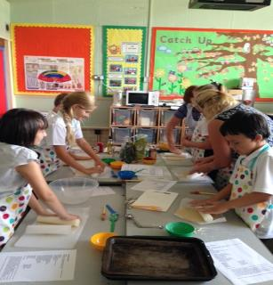


Extra Curricular Activties
Extra curricular work is seen as vital to the development of the whole child.
The school runs a breakfast club and many after school clubs.
Children are encouraged to join the variety of clubs offered by teachers. These clubs increase self esteem, broaden experiences, build confidence and provide experiences where success is shared.
Clubs are changed regularly and may include: Eco Club, Geography, Keep Fit, Orienteering, CREST Science, Netball, Football, Rugby, Cookery, Comic Club, ICT, Tennis, Lego

Slide 27
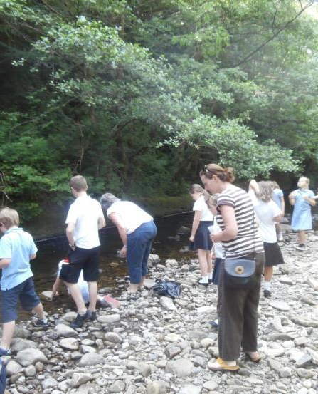
Outdoor Learning
Learning is greatly enhanced by the use of the outdoors.
The outdoors is used extensively by all pupils. The school has been involved in many outdoor projects including the clearance of the River Sirhowy and release of salmon.
The school provides waterproofs for pupils. Pupils in Foundation Phase need a pair of wellington boots and so too Eco Clubbers.

Slide 28
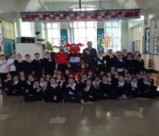
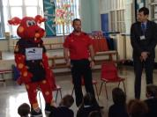
Attendance
Well done for attending school every day!
The school has set a target of 95.5% for the next academic year.
We rely on parents to ensure that children are absent only for genuine reasons. It is essential that children learn from an early age that attendance and good time-keeping are important.
Children who arrive after 9:00am and after the register has closed (at 9:15am) will be recorded late on the register.
If you child is absent from school due to illness please inform the school by 9.30 a.m. on the first day of absence. The school operates a ‘first day response’ system. If no message has been received by 10:00 a.m. the parent/guardian will be contacted for an explanation.
Please try and arrange medical and dental appointments outside of school hours to ensure that your child does not miss lessons.
The school’s Educational Welfare Officer visits the school on a regular basis, and after due consultation with staff will visit parents of any child who is persistently absent from school to discuss the reason for absence.
If a child is absent for any length of time, staff are more than happy to discuss, and provide, suitable work for pupils to do at home.
Children showing signs of sickness should be kept home from school. If your child’s illness is infectious, please inform the school immediately. If children are being treated with medicine or drugs which may affect their performance in school, it is wise to let us know.
If a child becomes ill or has an accident in school we may find it necessary to contact the parents. For this reason, we ask that you supply us with two emergency telephone numbers. If injuries occur which require immediate medical treatment the parent will be informed as soon as possible. In an emergency, however, the child’s best interest may be served by taking him/her for treatment immediately. Parents who object to this course of action, or know of any allergies their child has, should let us know immediately.
Sometimes for very good reasons, (medical or dental appointments), parents may wish their child to leave school early. We are always happy to co-operate, but in the interests of safety, no child will be allowed to leave school early unless collected by a parent or known adult.
If children need to be collected from school during lesson times then parents must report to the general office. The secretary will then arrange to collect the child from the classroom.

Slide 29
Family Holidays
EVERY DAY COUNTS
Every day counts in school and we ask that parents try to avoid booking holidays in school time. However, if you are unable to do this then please complete a holiday form (available from the office) if you intend to take your child out of school in term time in exceptional circumstances.
In exceptional circumstances a child may be allowed leave of absence from school for holidays of up to 10 days in any academic year, at the Head teacher’s discretion and only if attendance is above 95%. Any additional absence for holidays will be recorded as unauthorised absences.
As parents or carers you could receive a fine if your child has:
More than 5 days off school that are not authorized. These 5 days don’t have to be at the same time they can be at any time throughout the year.
At least 5 unauthorised days off for a holiday during term time
If your child is caught truanting and caught by the police.
Fines range from £60-£120 for one child then £120-£240 for two children.

Slide 30


Equal Opportunities for All
As a staff we endeavor to maintain an awareness of, and to provide for, equal opportunities for all children and adults.
We aim to take into account cultural background, gender and special needs in all aspects of school life, and to promote equal opportunities and good relations between persons of different racial groups, abilities and sexes.

Slide 31


Assessment
All nursery and reception children starting school will undertake activities on an initial assessment. The assessment covers language skills, mathematics and personal and social skills. Teachers will be able to use the information from the assessments to plan their teaching to match individual needs. Pupils in other classes are assessed under Teacher assessment agreed activities.
Target Setting
Target setting assists in providing clear educational direction for the work of the school. It provides a focus for raising standards and promoting pupils’ progress by concentrating, as appropriate, on improvements in the quality of teaching and quality of learning. In order to ensure that national targets and school targets are properly linked at Key Stage 2. The great majority of pupils should achieve at least a Level 4 by the end of Y6 in English, Mathematics, welsh and science. The expectation is that the great majority of pupils should achieve at least Outcome 5 by the end of Year 2. Just as all children are different so all year groups (cohorts) are different and we need to take this into account when setting targets. Therefore, each year appropriate targets will need to be set that are reasonable and fairly reflect the ability profile of the cohort. Clearly, therefore, we feel that it is unrealistic to expect a year on year percentage rise in the end of key stage assessment results.
Testing
Pupils will be asked to sit certain tests throughout their time in school. These tests provide information to aid your child’s progress. Staff always test pupils in a sensitive way in order to eradicate any stress or anxiety. Currently there are National tests in Literacy, Numerical Reasoning and Procedural Number for Year 2-6 pupils. These are sat in May.

Slide 32
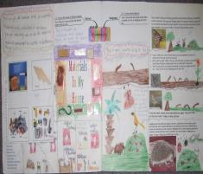
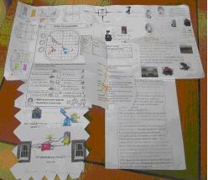
Homework
Without question, parental involvement in their child’s education is of great benefit in terms of progress and motivation for learning. Your input at home is highly valued by the school.
From an early age home/school links are encouraged particularly with regard to reading. Children are expected to take home books on a regular basis and to share reading with their parents. Other homework based around class topics and Literacy and Numeracy skills will be provided regularly and we encourage parents to support pupils in completing this via pupils Learning Logs.

Slide 33
Admission Procedures
The school is in an urban area and most of the children live quite close to the school. Some children live near Mynyddislwyn Church, which is in the catchment area. The catchment area spreads as far as Springfield in Pontllanfraith to the West and to Newbridge in the East.
Children are admitted to the Reception class at the beginning of the Autumn term provided they have reached the age of four by the preceding 31st August.
Nursery are admitted in September. The school also admits Rising Three’s in the Spring and Summer terms following the child’s third birthday.
No child will be excluded on the grounds of disability nor given any less favourable opportunities because of disability.
Arrangements are made for children to visit the Nursery or Reception class during the Summer term. Parents of Nursery class children are invited to visit the school prior to their child starting after confirmation from the Local Authority has been received. The school cannot guarantee places.
Parents seeking permission for their children to attend the school are invited to contact the Local Education Authority (LEA) as soon as possible. The LEA officer will then contact the school to make appropriate arrangements for admission. New parents are informed of a place by letter from the LEA.
Parents of Rising Three pupils must reapply for Nursery and for Reception. Please note places are not guaranteed and are strictly allocated by the LEA in accordance with their Admissions policy.

Slide 34
Admission Continued
RISING 3s :We accept ‘Rising 3s’ which means that your child can enter the school the term after their third birthday (Spring Term if their birthday falls in the Autumn Term and Summer Term if their birthday falls in the Spring Term). Application forms for admission as a Rising 3 can be obtained from the school office. These are then processed by the Local Authority and parents will be notified if a place is available. Parents of children due to attend our Nursery as a Rising 3 are invited to the school for “taster sessions”. We keep a waiting list of children and we encourage parents to place their child’s name on this list after their second birthday as this helps with forward planning.
NURSERY: Application forms for admission to Nursery are available from the school office. These are then processed by the Local Authority and parents will be notified if a place is available. Nursery children attend school on a part-time basis. Parents of children due to attend Nursery are invited to the school Parents of Rising 3 and Nursery children are invited in to school for “taster sessions”, and to obtain a “Starting School handbook”
RECEPTION: Children can be admitted to Reception in the Autumn Term if their fifth birth falls between 1st September and 31st August in that academic year. The majority of children transfer from the Nursery. Application forms for admission to Reception are available from the school office. These are then processed by the Local Authority and parents will be notified if a place is available.
IT IS VERY IMPORTANT TO COMPLETE APPLICATION FORMS FOR RISING 3s, NURSERY AND RECEPTION. IF YOU ARE GIVEN A PLACE FOR A RISING 3, YOU ARE NOT GUARANTEED A PLACE IN NURSERY OR RECEPTION
ADMISSION INTO YEAR 1 - YEAR 6 Admission to other year groups is done by contacting the school office or the Admissions’ Officer at CCBC. A mutually convenient time is arranged for you and your child to visit and tour the school, meet a member of the Senior Leadership Team, and the class teacher as well as discuss the school’s approach to learning.

Slide 35
Charging and Remissions Policy
Parents are asked for a voluntary contribution towards the cost of educational visits e.g. visits related to topic work being covered within the class.
The high cost of such trips cannot be paid for solely by school funds although such outings are often subsidised in order to reduce the cost to parents.
Where parents are worried about costs they should address their concerns to the Head teacher.

Slide 36

Governing Body
The Education Reform Act of 1988 has made Governors, in partnership with the Head teacher responsible for curriculum matters, school organisation, discipline, staff appointments, admissions to school, R.E., community use of the school, school activities and reporting to parents.
Since April 1994 the Governing Body has been responsible for overseeing the spending of monies allocated to the school. This is termed Local Management of Schools - formula funding.
Governors meet regularly to discuss school matters. An annual parents report is produced by the Governing Body.
The Governing body chairperson is Mrs F Wilkins

Slide 37

Complaints Procedure
The school is committed to dealing effectively with complaints.
We aim to clarify any issues about which you are not sure.
When you have a concern or wish to make a complaint we will usually respond in the way outlined in the School’s Complaints policy.
Sometimes you might be concerned about matters that are not decided by the school, in which case we will tell you who to complain to.
At other times you may be concerned about matters that are handled by other procedures, in which case we will explain to you how your concern will be dealt with.
The school has a Complaints policy a copy of which is available from the office

Slide 38
School Uniform
PLEASE LABEL ALL ITEMS OF CLOTHING
We encourage children to take pride in their appearance and in their school. We ask for your full cooperation in maintaining our high standards, as it aids discipline and identifies with the school.
Boys
Grey/black trousers
White polo shirt/shirt
Navy blue school sweatshirt
Black sensible shoes
Navy/Black coat
Black shoes
Girls
Navy skirt/pinafore/black trousers
Navy blue sweatshirt
White polo shirt/blouse
Black sensible shoes
Navy/Black coat
Black shoes
In the summer boys may wear short trousers and girls blue gingham dresses.
All children are expected to change for sporting activities.
Sports kit
White polo shirt and navy shorts
For health and safety reasons indoor P.E. activities require the children to be barefooted.
For outdoor games it is suggested that children are provided with a navy tracksuit and trainers.
It is very important that all items of clothing are clearly marked with the child’s name.
Pupils are not permitted to wear strappy tops in PE.
Upper KS2 pupils need swim wear: Girls a one piece swim suit and boys speedo type trunks.
All school clothing is available from Reggie’s in Newbridge, Triangle Trophies Crosskeys and local supermarkets.

Slide 39
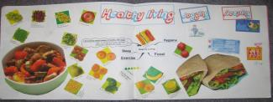
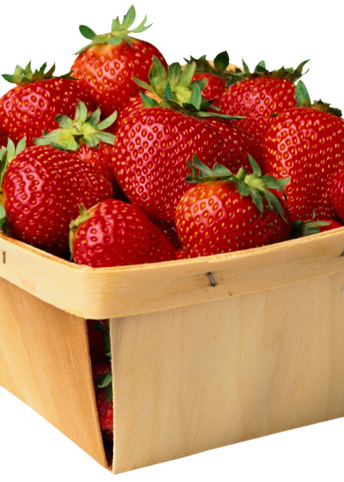


Healthy School Status
The school has a healthy school status.
This means that we have been able to demonstrate that we take healthy living and lifestyle as important aspects of a child’s education.
A fruit tuck shop is arranged for all pupils every day.
Fresh milk is supplied free to Foundation pupils funded by the Welsh Government.
Our pupils have unlimited access to fresh drinking water.
Pupils having packed lunch are also encouraged to make healthy and balanced choices.
We ask parents not to put confectionary i.e. bars of chocolate or sweets into packed lunches nor fizzy or high energy drinks. Glass bottles are not allowed for health and safety reasons.

Slide 40

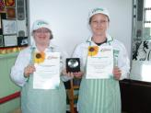
Breakfast Club
School Meals
A free Breakfast Club is run by Caerphilly Catering for pupils from Reception onwards.
Pupils are given a choice of cereals, toast and fruit plus a drink.
Breakfast Club starts at:
The last serving is at:
The school provides a varied and healthy menu and meals are eaten in the school hall under supervision. Children may purchase a school meal or bring in sandwiches. As we are a healthy school we ask parents not to put sweets or chocolates in children’s lunch boxes nor high energy drinks. Drinks must be carried in well sealed containers - glass bottles are not allowed.
School meals cost £1.90 per day, £9.50 per week. The menu for the week is placed on the canteen door and on the entrance door. If you child requires school lunch, payment is required on a Monday or the first day of the school week.
A register system and not meal tickets is used in the school. Credit is given for meals paid for but not taken, and a reduced sum can be sent the following week.
Dinner money paid by cheque ineeds to be made payable to C.C.B.C. If you have more than one child in school, a single cheque can cover all of the children. Please ensure that the name or names of your child/children are written on the back of the cheque.
Applications for free school meals may be obtained for the school secretary for pupils whose family income falls within certain scales laid down by the authority. Reapplication is necessary annually.

Slide 41
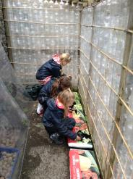

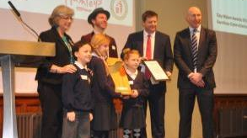
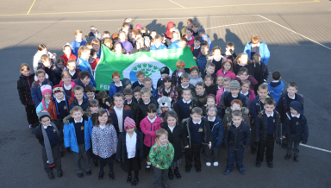
Eco Schools
The school has an active award winning Eco committee. The school has achieved Platinum Status and won the National Keep Wales Tidy Award. The committee works hard to promote sustainable living, care for the environment and global citizenship.
We recycle paper, plastic, batteries, card and have a compost bin for our vegetable and fruit waste. Pupils have access to class gardens, a bottle greenhouse and a woodland area.

Slide 42
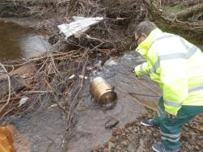
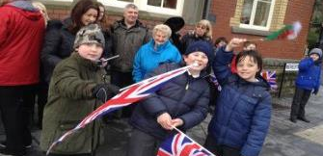
HOME SCHOOL LINKS
The school has a Home School Reading programme and parents are asked to assist us in listening to their children read.
Parents’ evenings are held in the autumn and spring terms. Here you will be able to discuss the progress and development of your child with the class teacher.
A written report for all pupils is issued at the end of the Summer Term.
Parents are very supportive and help out with fundraising, trips and activities.
We will advise parents should there be any concern with regard to their child’s behaviour, health, attitude or work. The welfare and progress of your child is enhanced by good cooperation between home and school.
Communication with parents is via Call Parents texting service so please inform us if your telephone number changes.
Information is also available on the school’s website.

Slide 43

P.T.A.
The school has a Parents Teacher’s Association called Partnership To Action.
It organises the school’s Annual Summer Fete and the Christmas Auction. Both events are very successful and help raise much needed funds for the school.
The PTA also assists with discos, parties and other fundraising events.
New parents are invited to join and are very welcome.

Slide 44

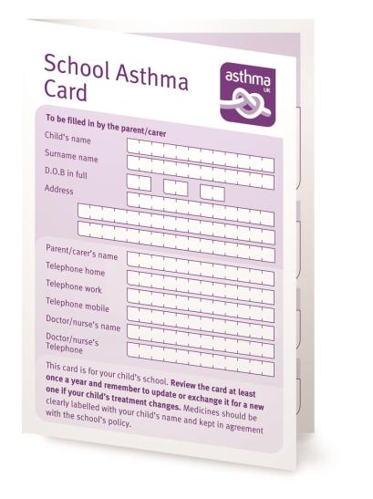
Medication
As part of our Health and Safety policy we do not administer any medication to children. It is essentially the responsibility of parents to ensure that a child receives medicines when necessary.
Parents may be asked to attend the school, wherever practical, to administer medicine to their children if they return to school before completing a course of medication, or if they suffer from long-term complaints.
Children who suffer with asthma should bring in inhalers. Younger pupils need to give them to their class teacher, who will store them safely and will ensure that the child has access at any time. Older pupils are encouraged to be responsible for their own pumps. All parents must complete an Asthma card for their child, and this must be signed by their doctor.

Slide 45

Medical and Dental
Please ensure that the school is informed about any medical conditions known to you that are likely to affect your child’s health and education.
At various times children will receive medical examinations such as dental examinations and eye tests, administered by the Local Health Board. Parents are notified before these examinations take place.
Responsibility for checking children’s hair for head lice now rests with the parent, and ought to be done on a regular weekly basis. If an outbreak is discovered please inform the class teacher. Pupils must be treated with a Head Lice lotion before they return to school.
The school nurse visits and appointments can be made for parents if requested.

Slide 46
Transition
Arrangements are made for our year 6 pupils to spend an induction day at Newbridge Comprehensive School, the designated secondary school for Pentwynmawr.
There are also a number of additional visits throughout the year. Pupils from years 5 and 6 take part in the annual concert at Newbridge, along with pupils from the other cluster schools.
The head of the school and members of staff visit our school and meet with the children to answer any questions they may have.
Year 6 pupils and their parents are invited to meet staff at an evening meeting at the comprehensive school and are given a tour of the school.

Slide 47


Transport
We would encourage you to walk your child to school if at all possible. If you have to bring your child to school by car please observe these simple rules to ensure safety:
Keep the yellow zigzag area clear.
Do not double-park.
DO NOT PARK IN FRONT OF THE SCHOOL GATES
All children and parents must use the playground entrance to the school.
Children should alight on the kerb side of the car.
All children should be safely strapped in with seat belts in transit.
PARENTS/GRANDPARENTS/CARERS ARE NOT ALLOWED TO PARK N THE STAFF CAR PARK. THE STAFF
CAR PARK IS IN CONSTANT USE BY DELIVERY LORRIES, CONTRACTORS VANS AND AGENCY WORKERS.
THIS IS A HEALTH AND SAFETY DIRECTIVE FROM THE LOCAL ATUTHORITY AND MUST BE ADHERED TO.

